Slide 1
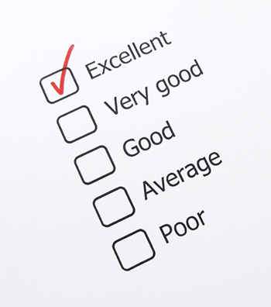
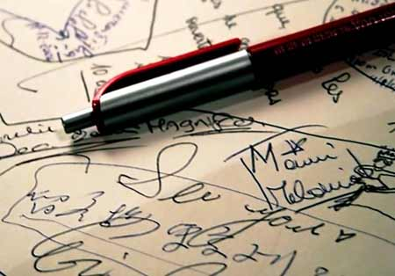
Chapter 7
Writing Process Phase 3:
Revise, Proofread, Evaluate

Slide 2
Revising, Proofreading, Evaluating
These are the final steps of
the 3x3 writing process.
3x3 writing process
Step 1: Analyze, Anticipate, Adapt
Step 2: Research, Organize, Compose
Step 3: Revise, Proofread, Evaluate

Slide 3
Revising
Revising is: Improving the content and sentence structure of your message.
Concentrate on:
Message clarity
Conciseness
Vigour
Readability

Slide 4
Revising
Revise for clarity:
A clear message is one that is immediately understood.
Express rather than impress.

Slide 5
K.I.S.S.
Keep It Short and Simple.

Slide 6
K.I.S.S.
Example of an unclear sentence:
Employees have not been made sufficiently aware of the potential adverse consequence involved regarding these chemicals.
Example of a clear sentence:
Warn your employees about these chemicals.

Slide 7
The Kitchen Test
The Kitchen Test:
If a sentence doesn’t sound natural
in your kitchen, it needs revision.

Slide 8
Other Revising Tips
Eliminate fillers
Long lead-ins
Redundancies
Compound Prepositions
Empty Words

Slide 9
Other Revising Tips
Transform wordy noun phrases into active verbs:
Eg.
-give consideration to ---> consider
Avoid overused business expressions such as:
- Enclosed please find.
- Please do not hesitate to.

Slide 10
Other Revising Tips
Use parallelism, headings and bullet lists to highlight ideas.
Use CAPITALIZED LETTERS, bold, italics and blank spaces to improve readability.

Slide 11
Proofreading
Proofread after you’ve completed the
first draft.
Put yourself in a “find the errors mindset” and read slowly.

Slide 12
Proofreading
Check for spelling, grammar, punctuation, names, numbers and format.
Finally, read the document once more.
If possible, find a friend to proofread.

Slide 13
Evaluating
After revising and proofreading, it’s time to evaluate your message.

Slide 14
Evaluating
Ask yourself:
How successful will this message be?
Does it say what I want it to say?
Will it achieve my purpose?
Does my message contain credible evidence?

Slide 15
Feedback
Feedback is the best way to
evaluate your writing.
Feedback will allow you to improve your communication skills thanks to the receiver’s comments.

Slide 16
Bibliography
Mary Ellen Guffey, Kathleen Rhodes, Patricia Rogin. Business Communications: Process and Product. United States. Nelson Education. 2010

Slide 17
Additional Resources
For additional information about the Business Writing Process go to :
http://www.zenome.com/directory/index.php?parentID=007.063.007&desc=07-

